Slide 1
Notes:
Copyright 2005, Eric Dombach, Business Action, Inc. DBA The Coaches' Coach

Slide 2
A Guided Tour of Our Future
Your Name Here
January 1, 2009

Slide 3
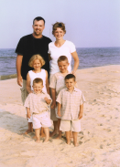
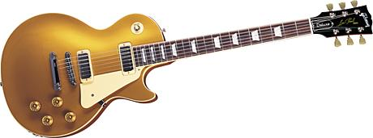
The 10 Life Categories
Spiritual
Marriage
Family
Church
Financial
Business
Fitness
Growth
Hobbies
Social

Slide 4
Spiritual Goals
Daily
Every two days
Attend each week

Slide 5
Marriage Goals
Recreation
Ball room dancing in
Europe in
Home
Hot tub in

Slide 6
Family Goals
Each child a minority shareholder and managing partner of a small business to fund their cars and college
Each child educated in a university chosen on the basis of it’s ability to assist us in preparing our child for his/her unique calling

Slide 7
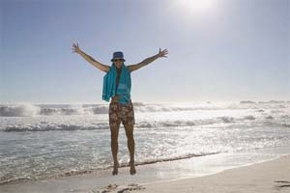
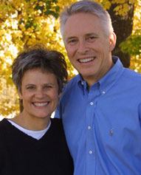
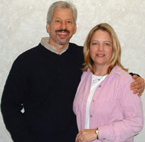
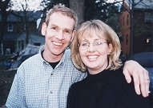
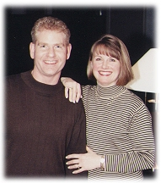
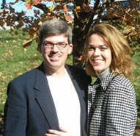
Church Goal

Slide 8
Financial Goals
$____ earned income in 2008
$____ passive income in 2008
$____ net worth by end of 2008
$____ GIVEN AWAY in 2008!

Slide 9
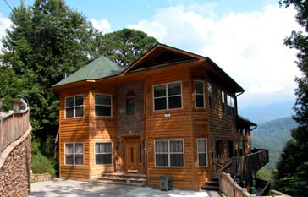
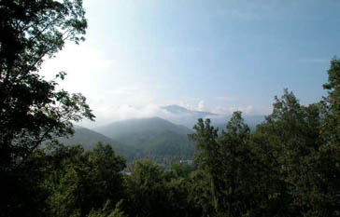
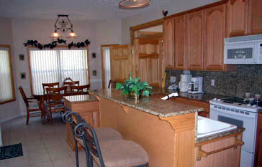
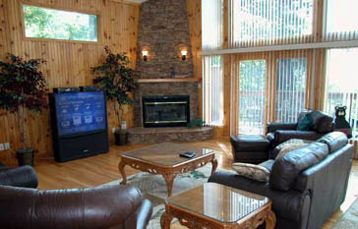
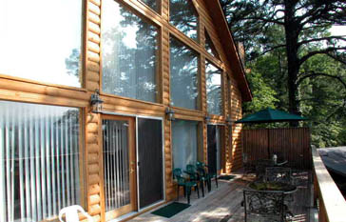
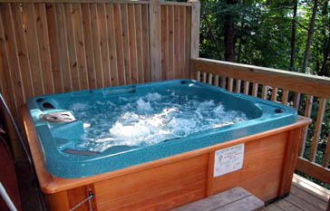
Family Property
Mountain Vacation Home

Slide 10
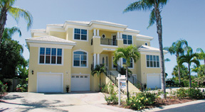
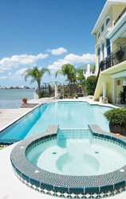
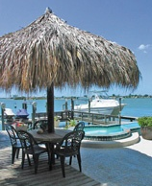
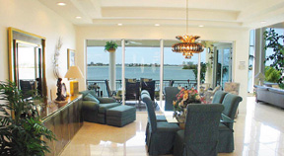
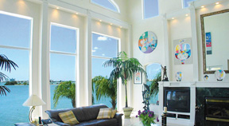
Family Property
Summer Vacation Home

Slide 11
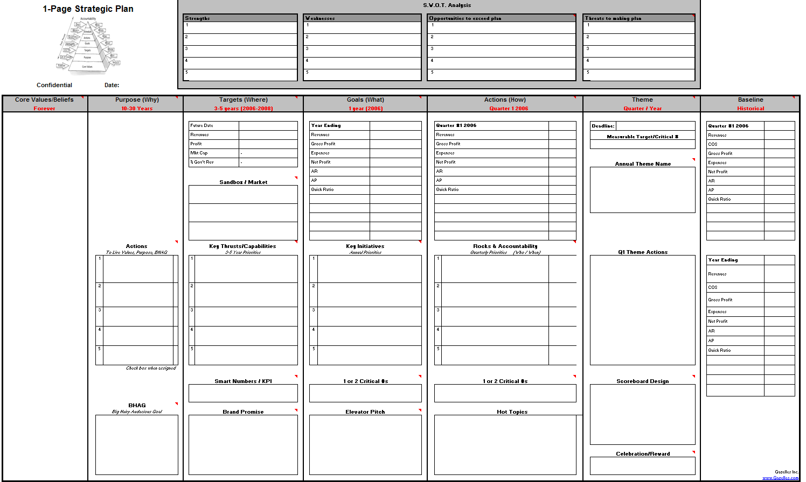
Team Synergy Action Coaching Firm in every ML territory in the world…
Business Goals

Slide 12
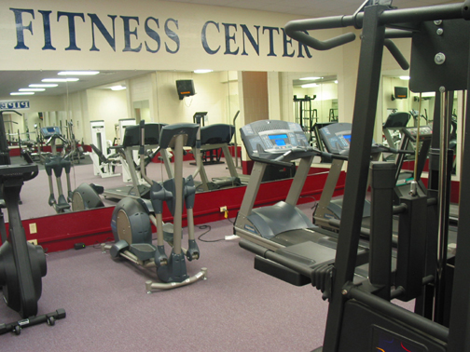
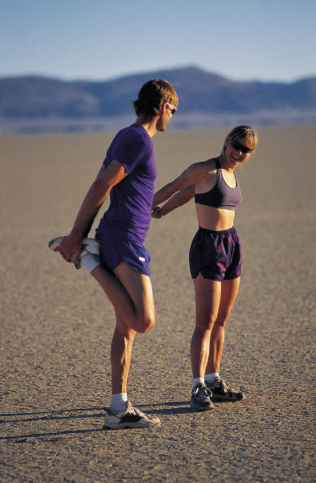
Fitness Goal
Ideal body weight: ___#
Work out 3x per week
1 gallon of water per day
Nutritional supplement regime 2x per day

Slide 13
Growth Goals
Certification in ____________
Masters in ___________
Doctorate in ____________

Slide 14
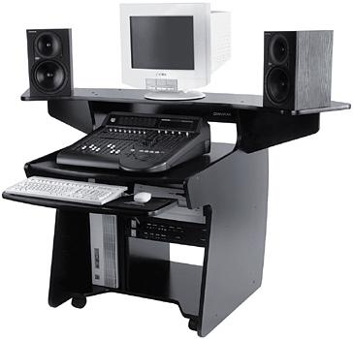
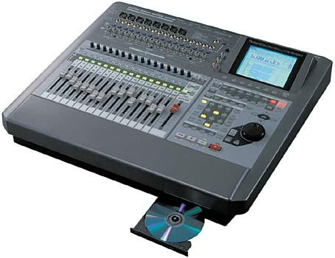
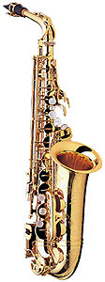
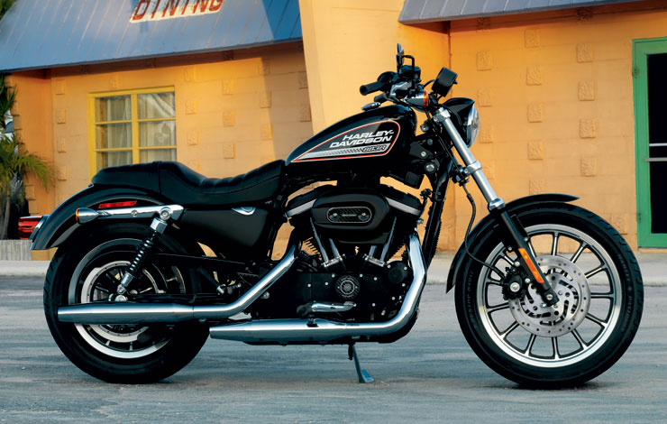
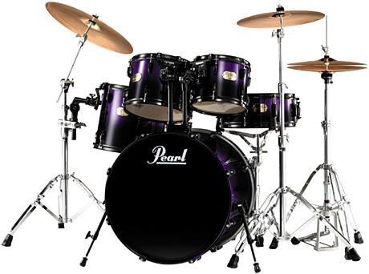
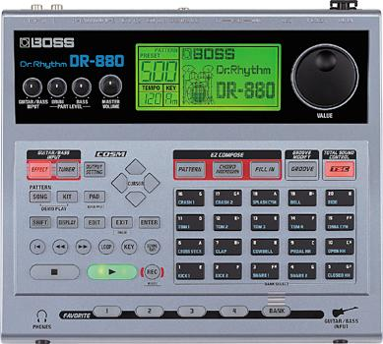
Hobby Goals
Harley-Davidson XL 883R Sportster
Music, video editing suite completed

Slide 15
Social Goals
1 Week in Europe, 1 Week in Carribean

