Slide 1
Time Management Plan
How-To Guide

Slide 2
HOW TO: Time Management Plan (TMG)
An intentional plan for investing your time wisely by blocking high-value activities into a default calendar as appointments and holding yourself accountable for executing them on time.

Slide 3
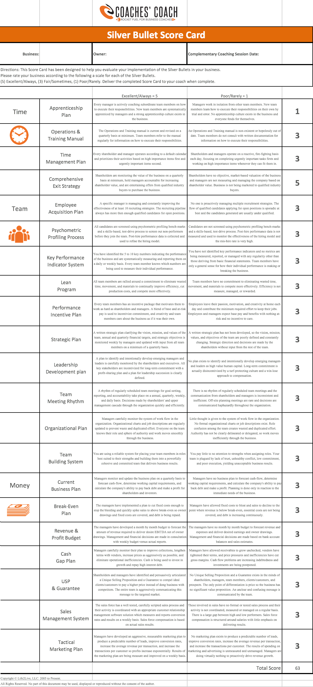

Slide 4
Silver Bullet Scorecard
Score: 5
Score: 1
You and your team invest your time wisely by blocking high-value activities into a default calendar so that you complete the highly-important activities first and urgent items second.
You and your team operate without a default calendar and spend your time reactively, prioritizing urgent tasks and working on the most highly-important activities when you can fit them in.

Slide 5
HOW TO: Time Management Plan (TMG)
Coach review Time Management Plan slides with Client, including the Time Management Matrix concept.
Client read 7 Habits of Highly Effective People by Stephen Covey
Client complete the Simple Time Study to identify how time is being used throughout the week and which quadrant Client is spending time in.
Client use the Time Management Matrix to identify the tasks that should be delegated to other team members.
Coach help Client develop an Apprenticeship Plan to delegate tasks. Alternatively, the client may elect to recruit a new team member into the business using an Employee Acquisition Plan and the Psychometric Profiling Process. However, this should be done only if the additional fixed cost payroll is easily affordable.
Client create a Default Calendar that prioritizes the Quadrant 2 tasks.
Coach hold the Client accountable for executing the Default Calendar.

Slide 6
Reproduce
Acquire
Harvest
5
Economize
Systematize
Specialize
FREEDOM
Research
Model
Launch
Measure
Incent
Expand
4
PROSPERITY
Invest
Grow
Team
1
3
CREATION
CONTROL
2
CHAOS
Notes:
The Psychometric Profiling Process is one of the strategies we do… Fill in script here please - HD

Slide 7
Economize | Systematize | Specialize
4
4
PROSPERITY
PROSPERITY
Time Management Plan An intentional plan for investing your time in the highest value activities by blocking tasks into your calendar as appointments and making yourself accountable for executing tasks on time.
Team Meeting Rhythm A disciplined rhythm of recurring team meetings focused on reporting, accountability, alignment, and goal-setting that occur on an annual, quarterly, weekly, and daily basis.
Operations & Training Manual An evolving "How-to" guide that describes in great detail everything a team member must know to fulfill the duties of their position and guides them through a complete training process.
Lean Program An ongoing program for rallying your team around a commitment to eliminate wasted time, material, and movement so you can dramatically improve operational efficiencies, cut production costs, and compete more effectively.

Slide 8
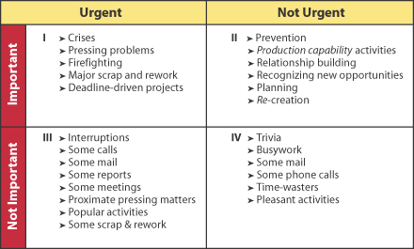
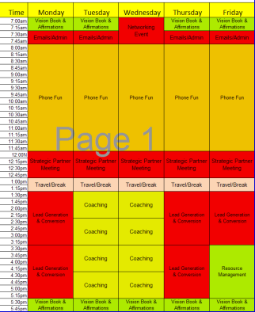
Time Management Plan (TMG)

Slide 9
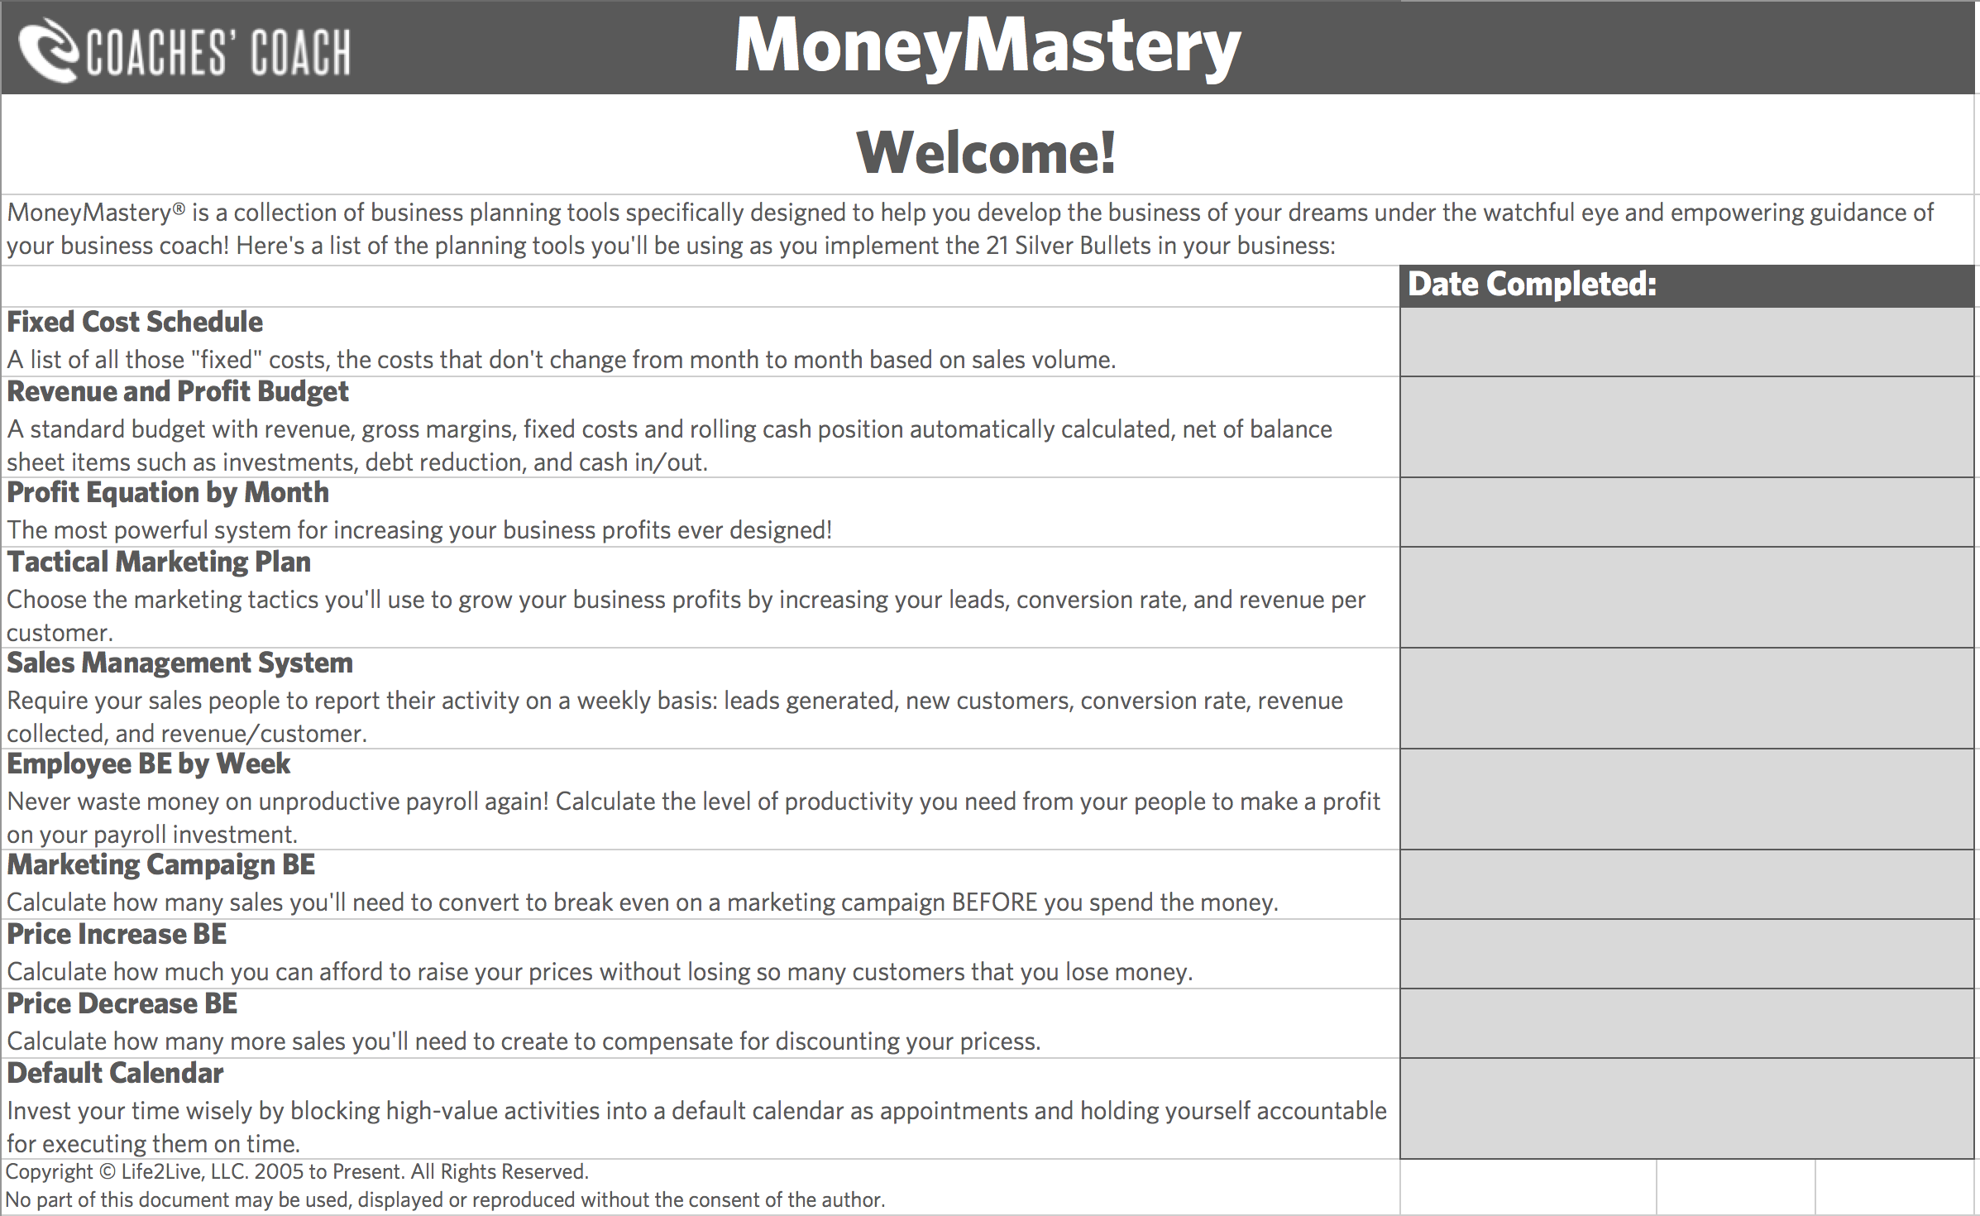

Slide 10
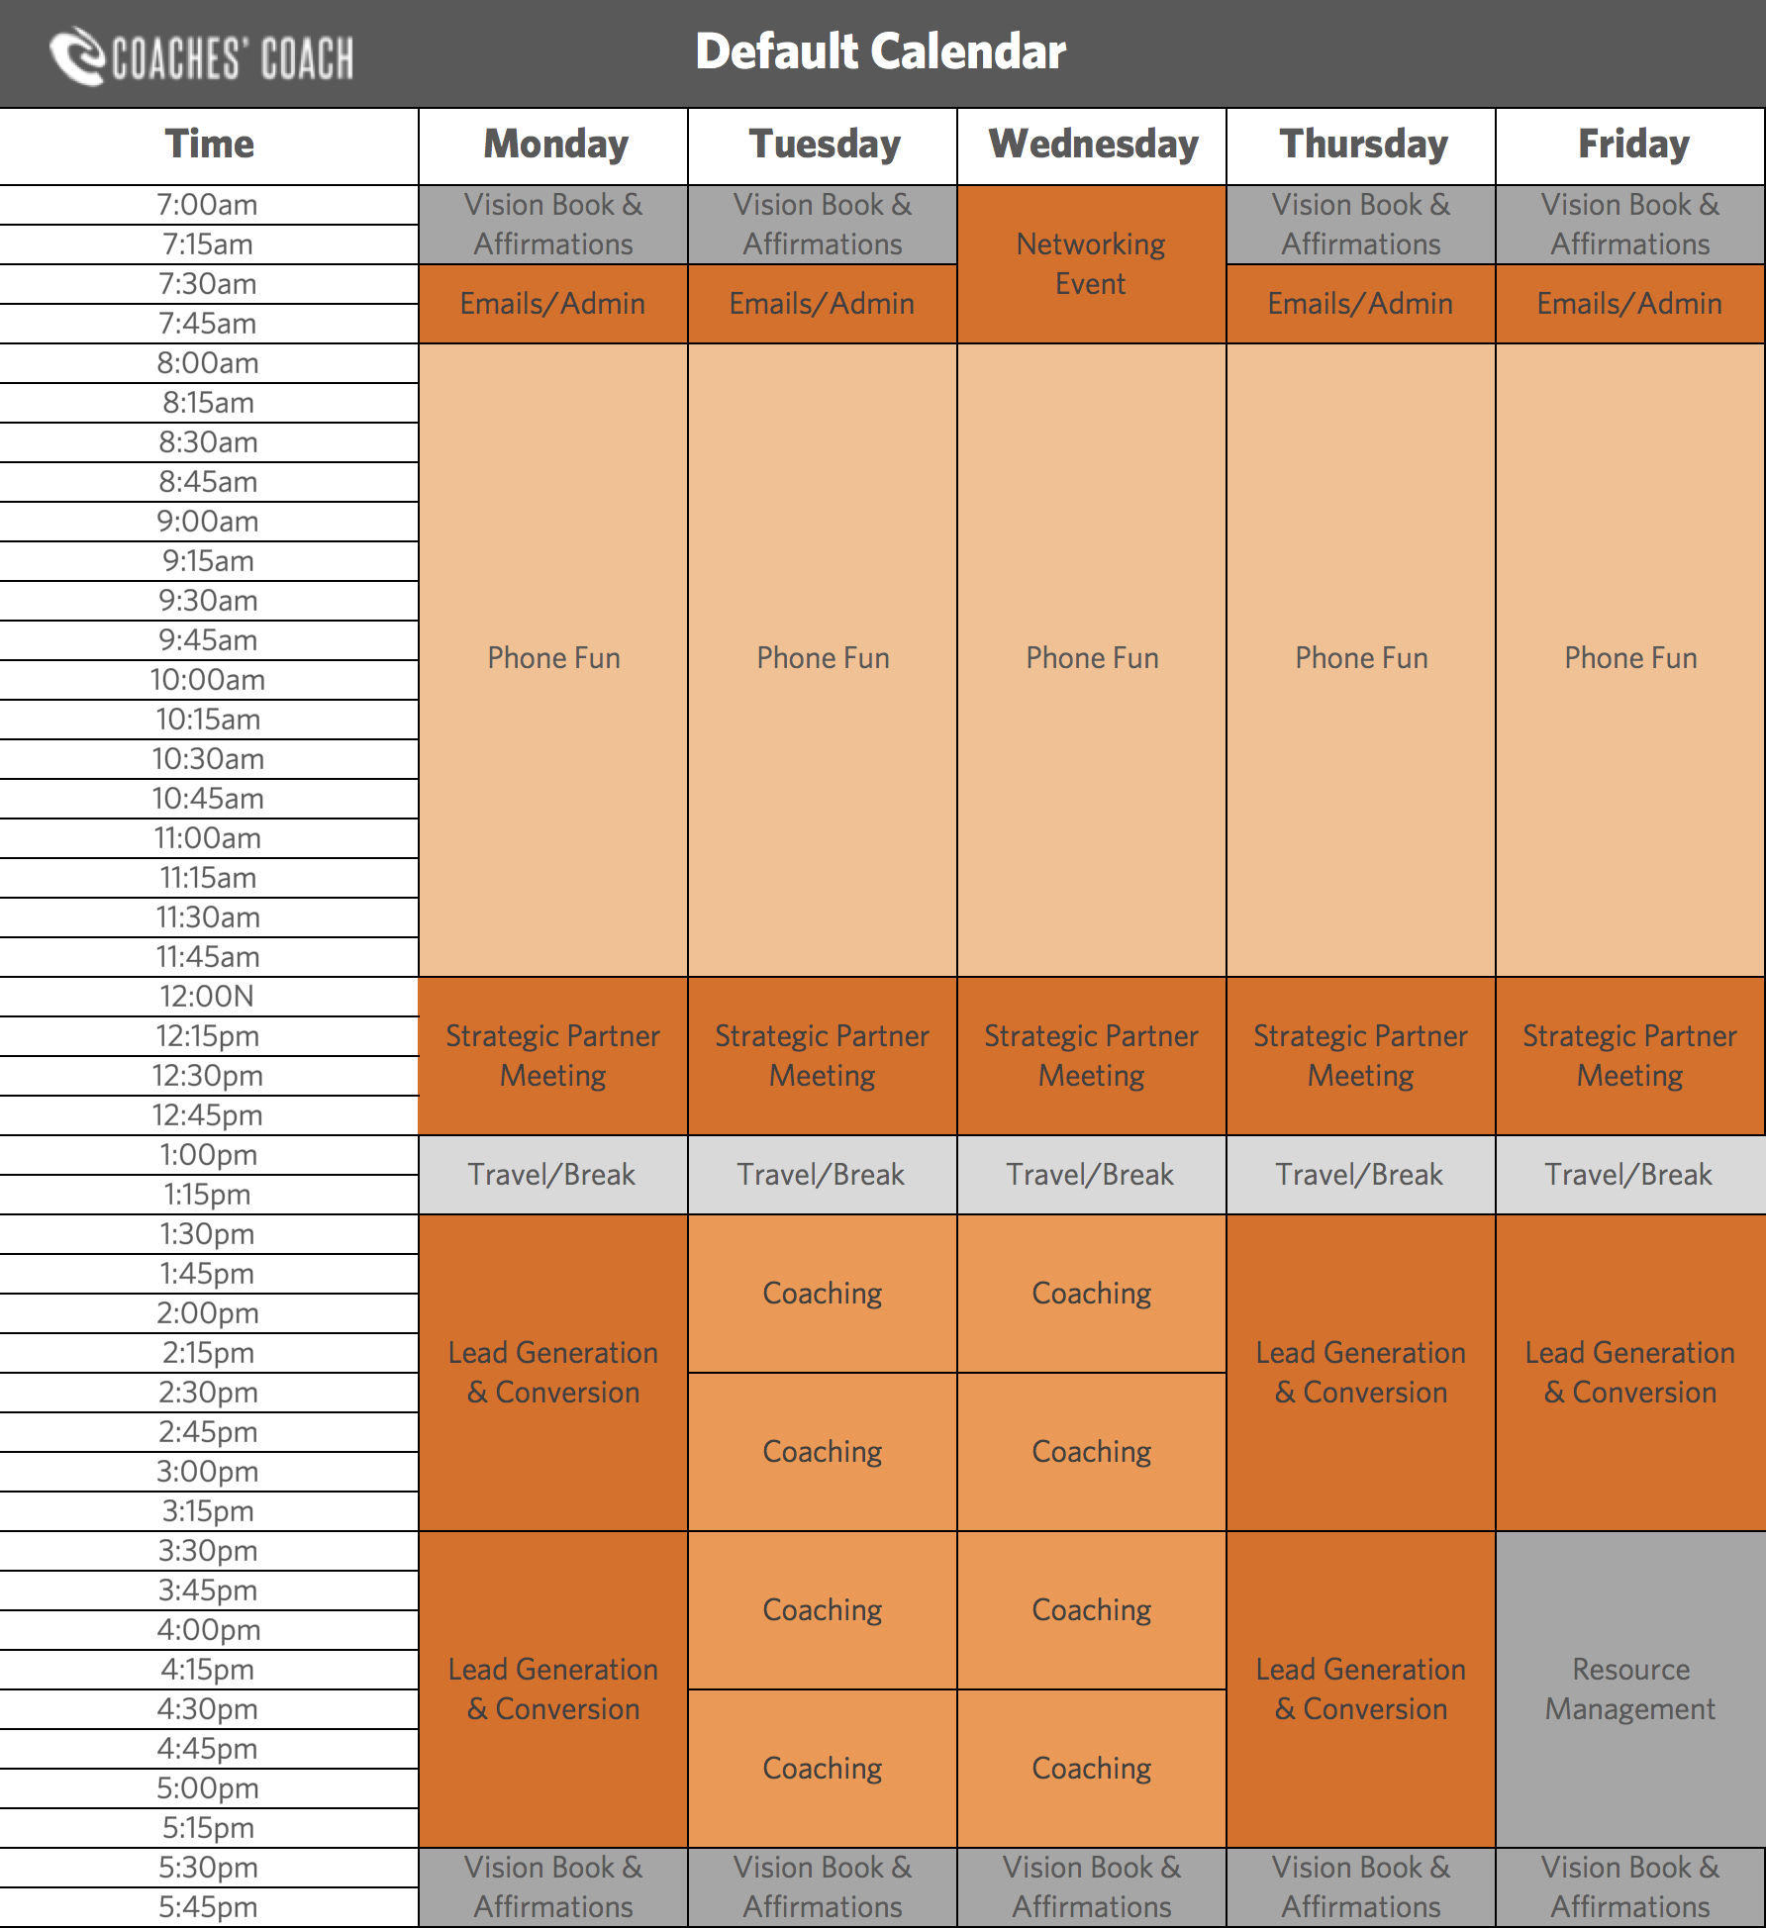
Notes:
Replace with updated screenshot

Slide 11
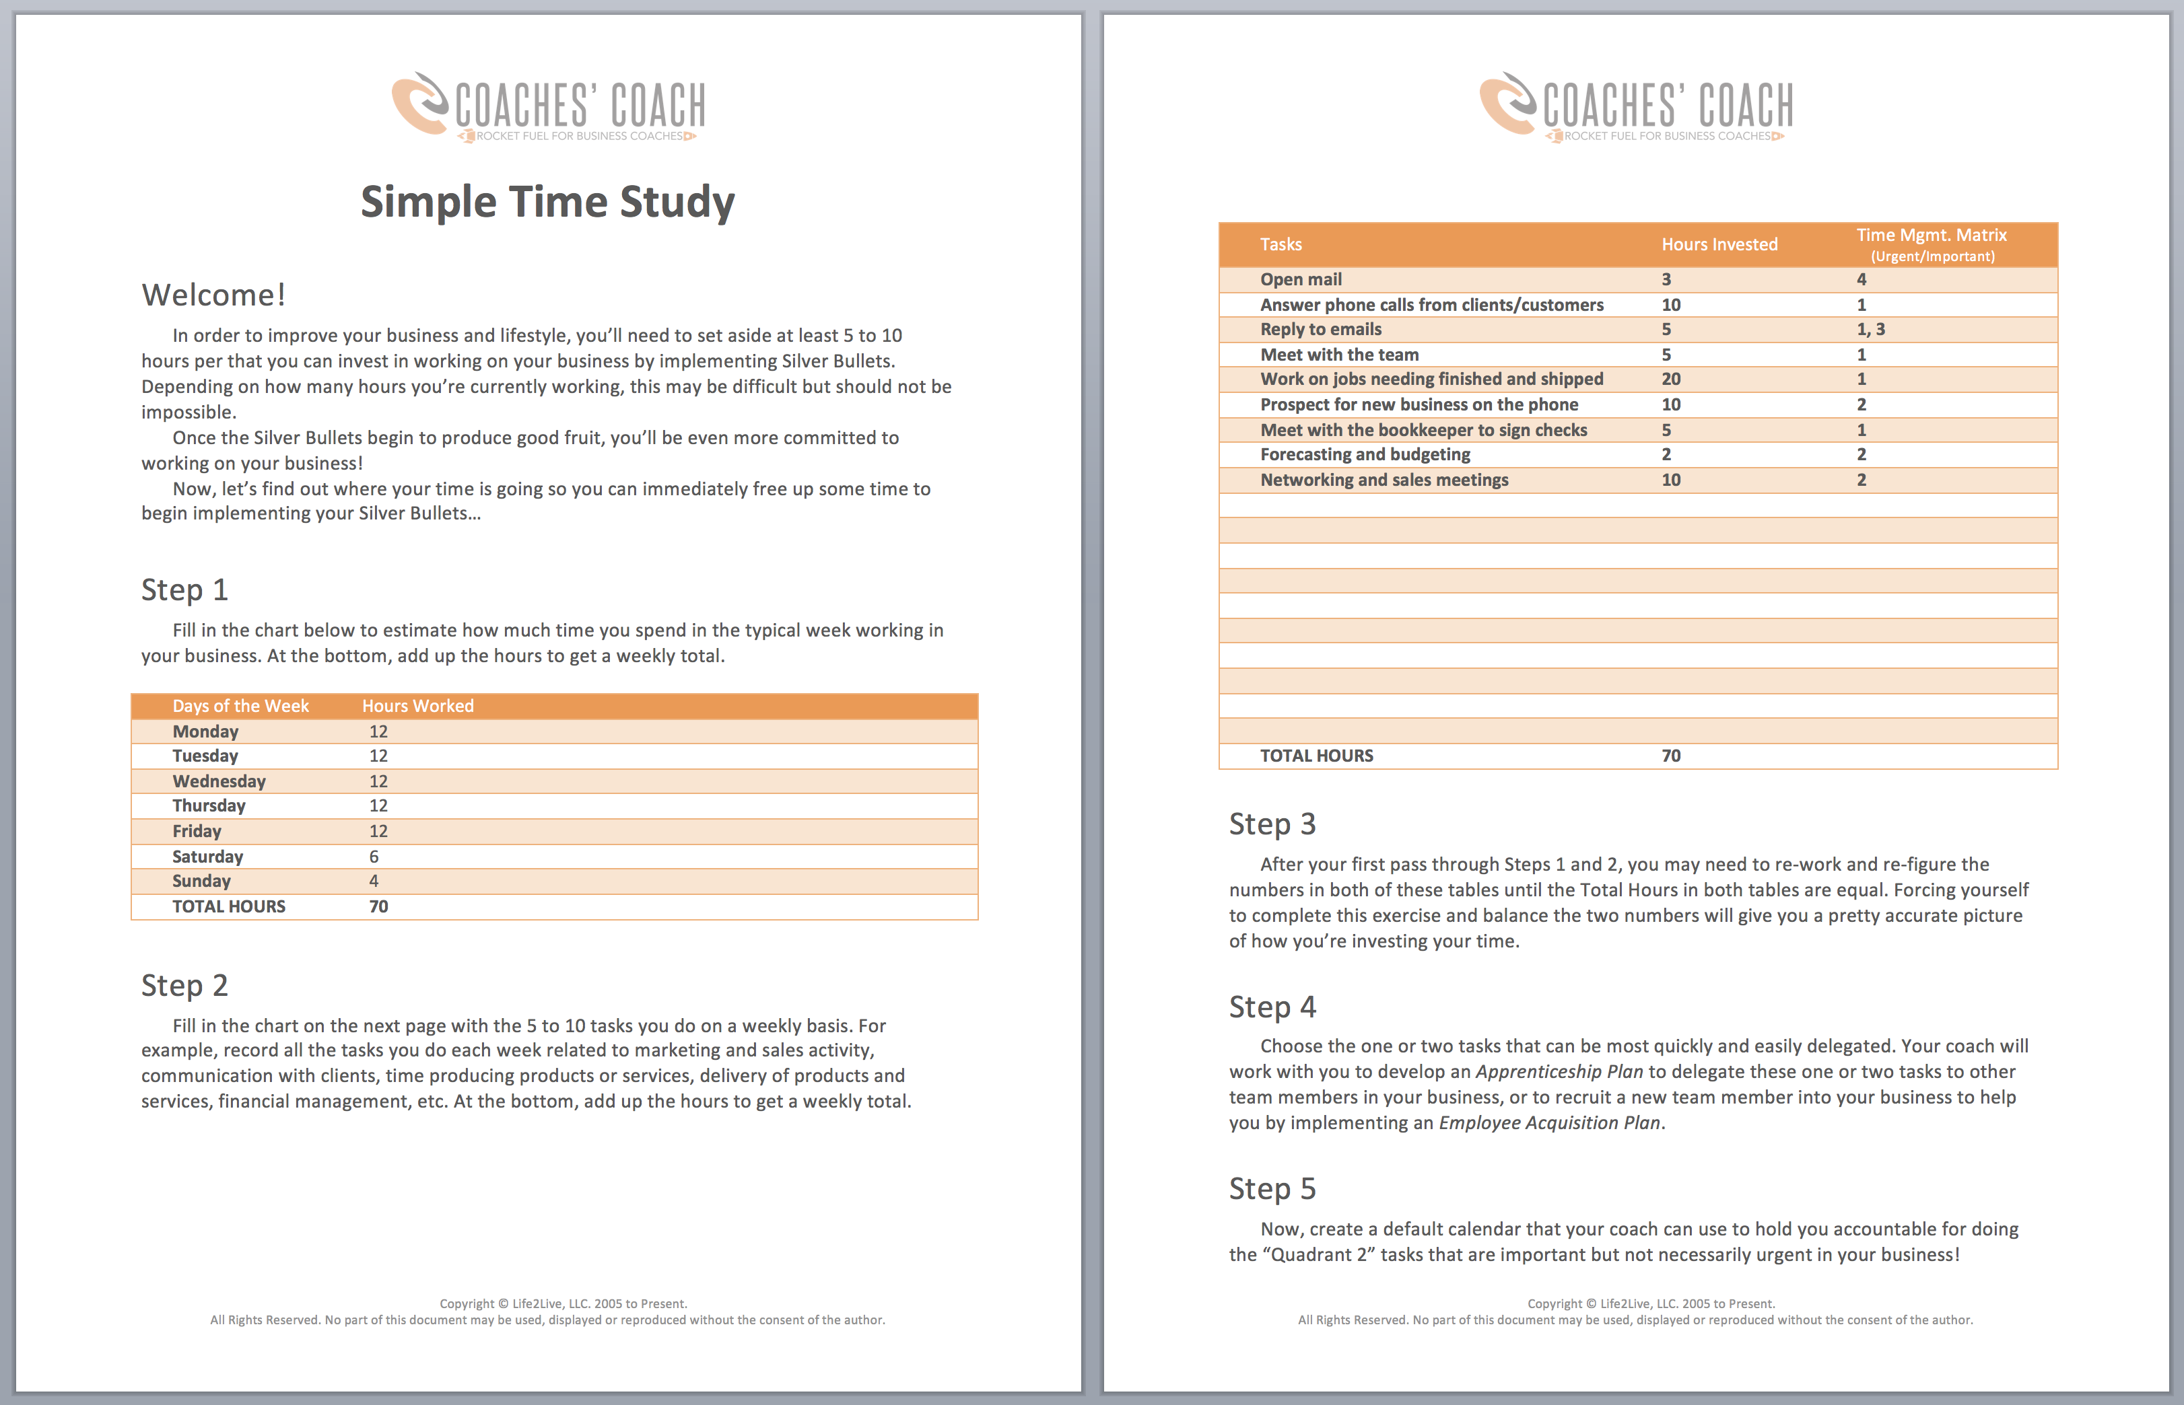
Notes:
Replace with updated screenshot

Slide 12
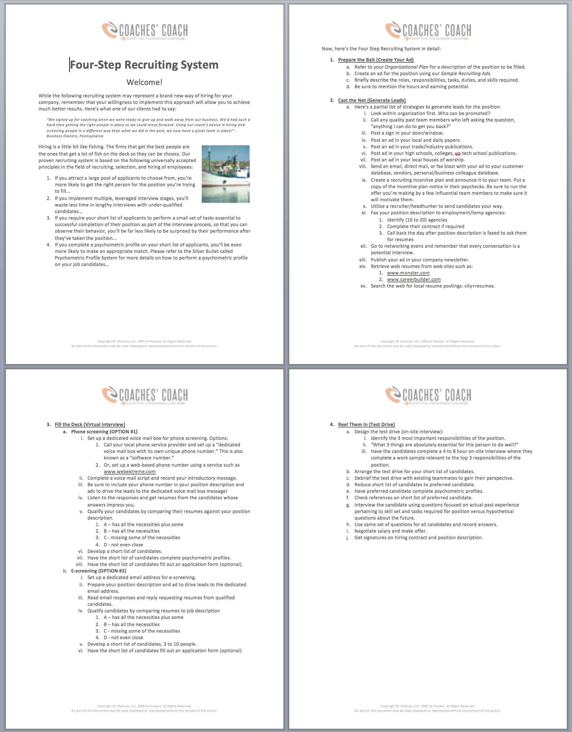
Time Silver Bullets

Slide 13
Notes:
Replace with updated screenshot

Slide 14
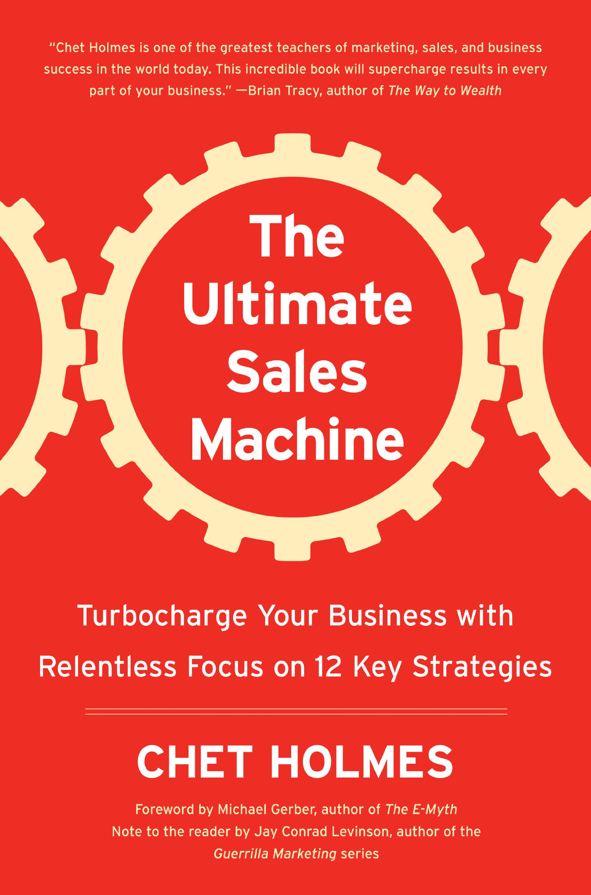
The 6 Steps to Great Time Management
Touch it once...
Make lists...
Plan how much time you will allocate to each task...
Plan the day...
Prioritize...
Ask yourself, “will it hurt me to throw this away?”

Slide 15
Copyright Notice
Copyright © Life2Live, LLC. 2005 to Present. All Rights Reserved. No part of this document may be used, displayed or reproduced without the consent of the author.

