Slide 1
Vision Book 20_ _
A Guided Tour of My Future

Slide 2
Daily Bible reading
Attend church each Sunday
Volunteer 1 evening per week
1. Faith

Slide 3
Celebrate big time each special day: Valentine’s, birthday, anniversary
Ball room dancing class weekly
Enjoy week in the Caribbean
Add a hot tub in the back
2. Fidelity

Slide 4
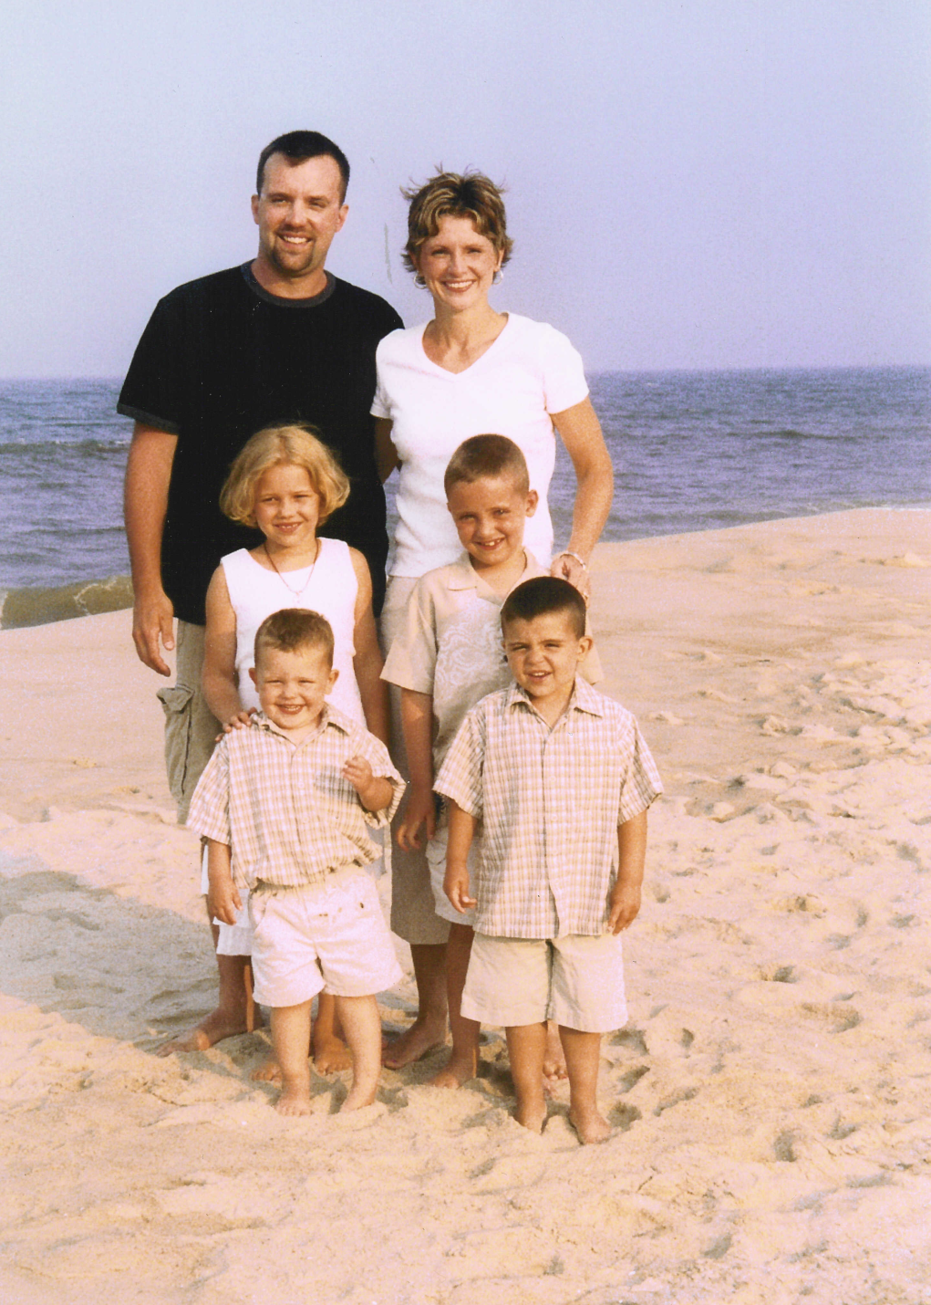
Each kid a managing partner their own small business to fund their cars and college
Each kid in D1 University either majoring or minoring in business
3. Family

Slide 5
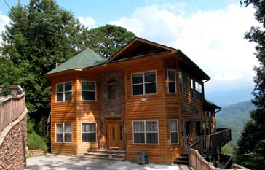
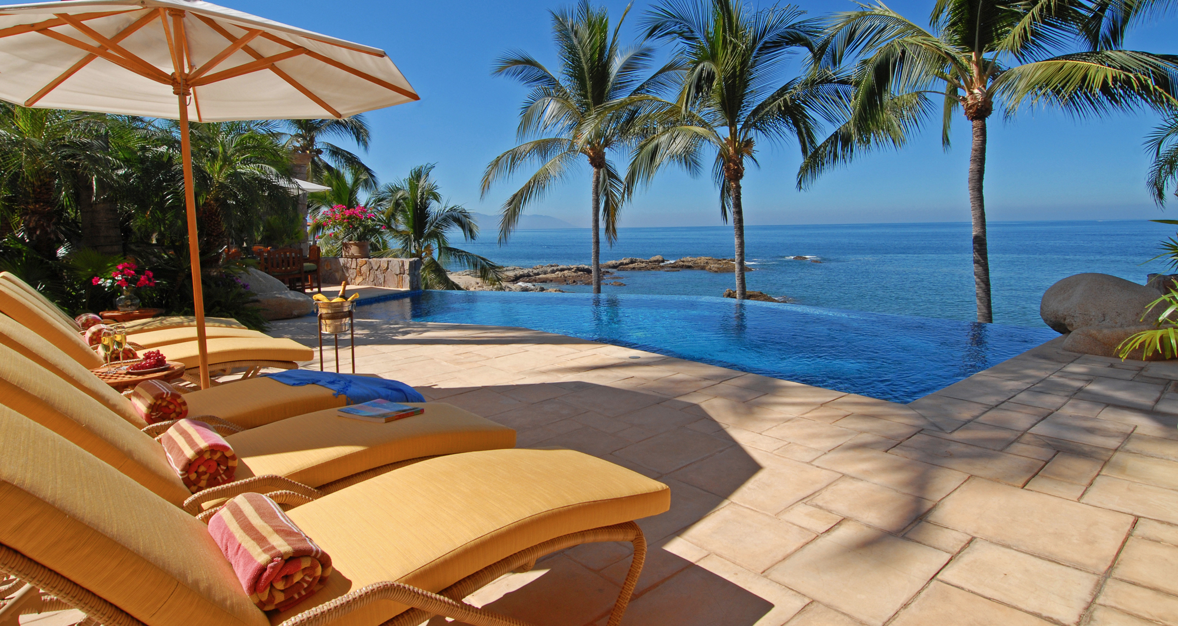
Mountain Vacation Home
Summer Vacation Home
3. Family

Slide 6
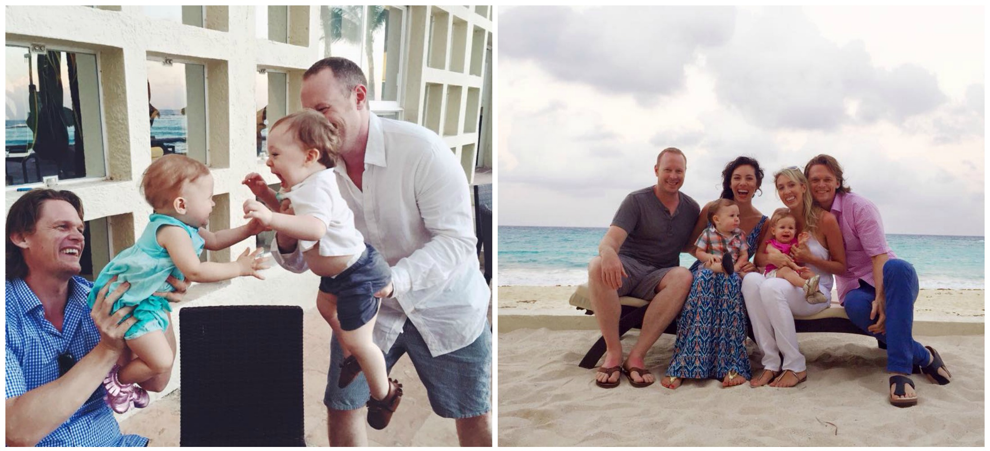
4. Friends

Slide 7
$____ earned income in 20_ _
$____ passive income in 20_ _
$____ net worth by end of 20_ _
$____ GIVEN AWAY in 20_ _
5. Finances

Slide 8
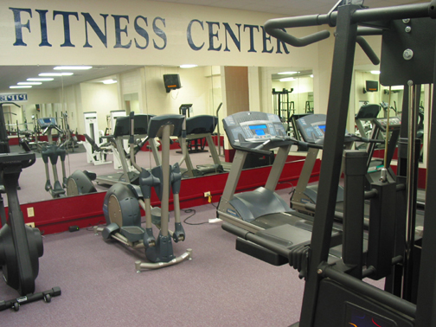
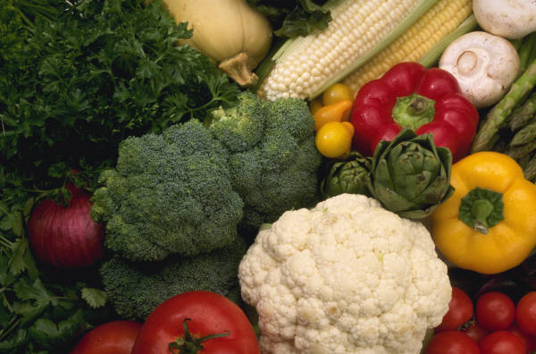
Hit ideal body weight: ___#
Work out 2x per week
Drink 1 gallon of water per day
Nutritional supplement regime 2x per day
6. Fitness

Slide 9
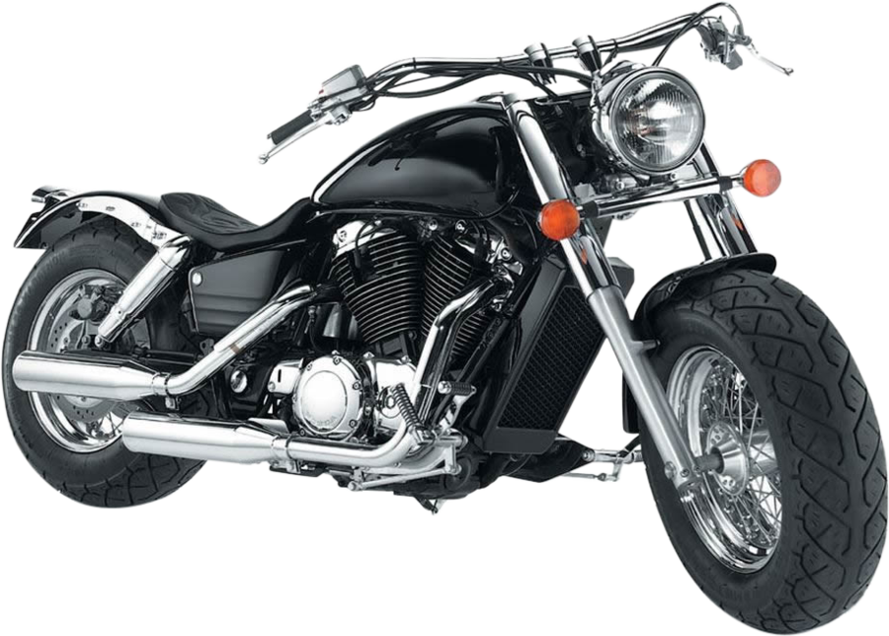
Music, video editing suite completed
Harley-Davidson XL 883R Sportster
7. Fun

Slide 10
The 7 Fs of a Full Life
1. Faith
2. Fidelity
3. Family
4. Friends
5. Finances
6. Fitness
7. Fun

Slide 11
Copyright © Life2Live, LLC. 2005 to Present. All Rights Reserved. No part of this document may be used, displayed or reproduced without the consent of the author.

